Slide 1
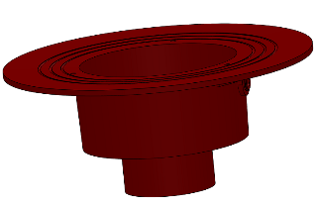
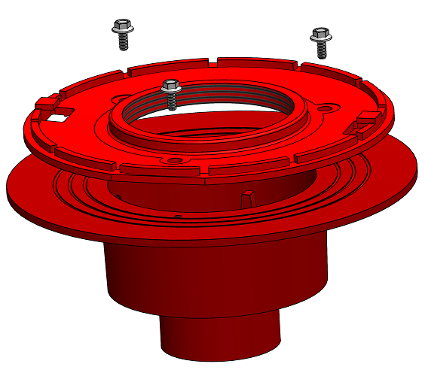
R1200-ES – INSTALLATION GUIDE
1. Attached A2-BODY to the drainpipe using MI-XHUB coupling
2. Assemble the clamp (A2-C3-Wx) using provided hardware. (If a membrane is requested at this level shall be applied prior clamp installation).
Note: “-x” stays for the optional size of 4”; 6”; 8” or 10”.

Slide 2
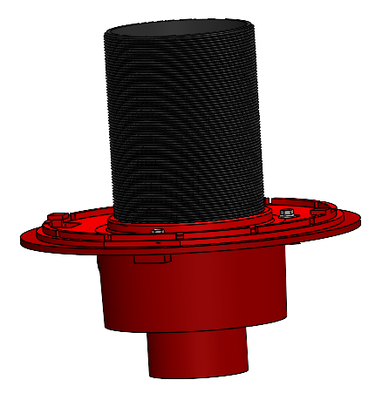
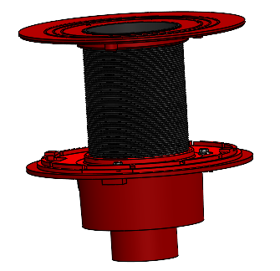
3. Install the ABS nipple (Wx-PN9R) by screw it into the threaded clamp
4. Install the top component (A2-ES-x) by thread it onto the nipple and adjust the height.
Height can be adjusted by threading the nipple into the lower clamp, or even cut the nipple.
Use silicone to water seal around top and bottom nipple connections after the height is set.
Apply silicone
Note: “-x” stays for the optional size of 4”; 6”; 8” or 10”.

Slide 3
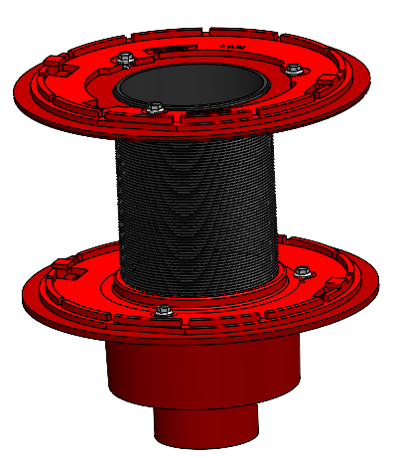
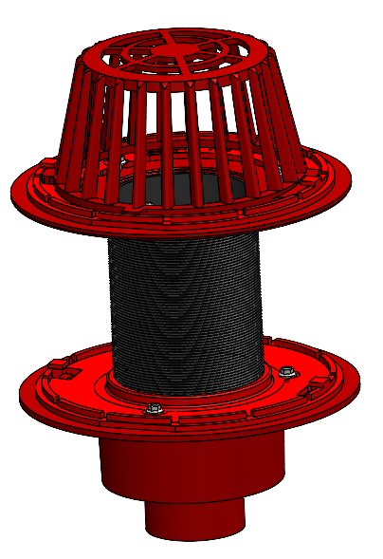
5. Install the insolation membrane followed by the upper clamp (A2-C3)
Secure the clamp with provided hardware.
6. Attached the dome (A2-MD) and rotate it clockwise to secure in place.
Note: “-x” stays for the optional size of 4”; 6”; 8” or 10”.

Slide 4
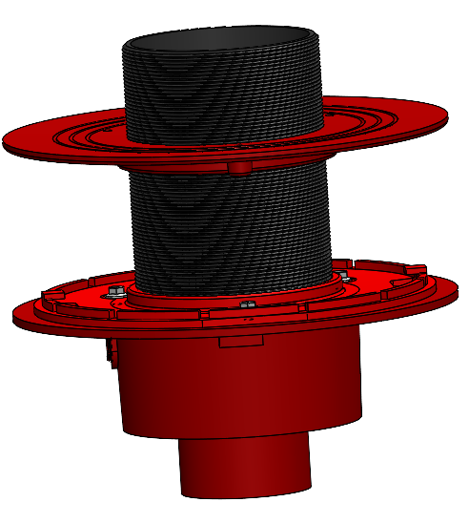
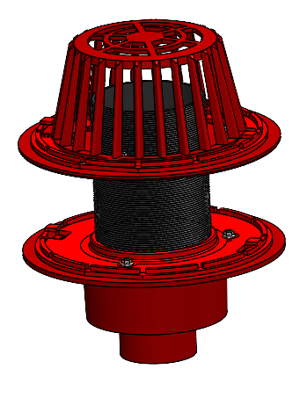
Overflow
7. If an overflow is required, simply screw the top component (A2-ES-x) down on the nipple to obtain the dimension needed.
Note: “-x” stays for the optional size of 4”; 6”; 8” or 10”.

